Slide 1

SecureVote: Blockchain Voting Application
Ensuring Trust and Transparency in Digital Elections
Siva Parvathi & Renuka
Full-Stack Development Team

Slide 2
The Challenge: Trust in Digital Elections
In an increasingly digital world, the integrity of voting processes faces significant scrutiny. Traditional online voting systems often lack the transparency and immutability required to build public trust, leading to concerns about:
Voter Impersonation
Data Manipulation
Lack of Transparency
Ensuring each vote comes from an eligible, unique individual.
Preventing unauthorized alteration of votes or results.
Providing verifiable proof that all votes are counted accurately.
Our solution addresses these critical issues by leveraging blockchain technology for unparalleled security and verifiability.

Slide 3
Intuitive User Experience: Wireframe Overview
Our design prioritizes a seamless and secure user journey, from registration to casting a vote and viewing results. The wireframe illustrates the key stages users will navigate:
1
2
Aadhaar & OTP
Wallet Connect
Secure identity verification.
Linking to the blockchain securely.
3
4
Voting UI
Live Results
Proposals, party symbols, and vote casting.
Real-time, dynamic data visualization.
This streamlined flow ensures ease of use while maintaining robust security at every step.

Slide 4
The SecureVote Solution: A Three-Layered Approach
Our blockchain voting application is built on a robust, multi-layered architecture designed for security, transparency, and scalability.
Frontend: User-Centric Design
Backend: Secure & Scalable Data Management
Blockchain: Trust & Immutability
Built with React, TypeScript, Vite, shadcn-ui, and Tailwind CSS, the frontend provides a responsive, modern, and intuitive user interface. Features include:
Powered by Node.js, Express, and MongoDB (Mongoose), the backend ensures secure user authentication and vote storage:
Utilizing the Aptos blockchain and Move language for core voting logic and transparency:
On-chain proposal management
Aadhaar registration & OTP verification
Aadhaar & OTP API for secure authentication
Enforced one-vote-per-address logic
Aptos wallet connection
All critical votes recorded on-chain for verifiability
Dynamic voting interface with party symbols
User and vote storage to prevent double voting
Move's resource safety for data integrity
Real-time result dashboards
Policy management for government or DAO proposals
Ensures only authenticated users can vote once

Slide 5




Unwavering Security & Integrity
At the core of SecureVote is a commitment to security and data integrity, ensuring that every vote is authentic, unique, and verifiable.
Aadhaar & OTP Verification
One Vote Per User
On-chain Transparency
Eliminates fake registrations, ensuring only eligible citizens vote.
Enforced by both backend logic and the Aptos smart contract, preventing duplicate votes.
All crucial voting data is immutably stored on the blockchain, providing a publicly verifiable audit trail.

Slide 6
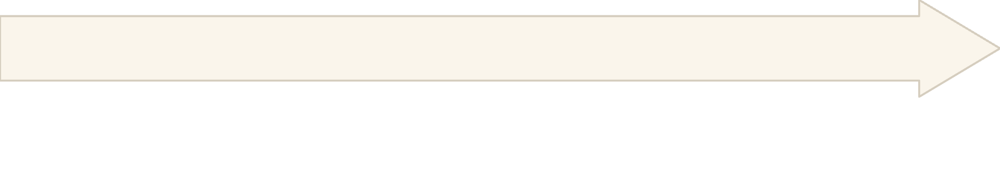

The Voting Workflow: Step-by-Step
Our streamlined workflow ensures a smooth and secure voting experience for every user.
Wallet Connection
User Registration & Verification
The user connects their Aptos wallet, linking their verified identity to a unique blockchain address.
User enters their Aadhaar number, receives an OTP, and verifies their identity. This is managed by the backend API.
Real-time Results & Analytics
Vote Casting
Immediately after voting, the user sees live results, dynamic charts, and detailed analytics reflecting the current voting outcome.
User selects a proposal or policy and casts their vote. The backend validates eligibility and records the vote in MongoDB and on-chain via the Move contract.

Slide 7



Versatile Applications: Beyond Elections
SecureVote's robust framework extends beyond traditional elections, offering transparent and auditable decision-making for various organizations.
Government Elections
Policy Referendums
DAO & Community Governance
Conduct national, state, or local elections with enhanced security and public trust.
Facilitate transparent voting on government policies or community-wide initiatives.
Enable decentralized autonomous organizations (DAOs) and communities to make collective decisions with full transparency and auditability.

Slide 8

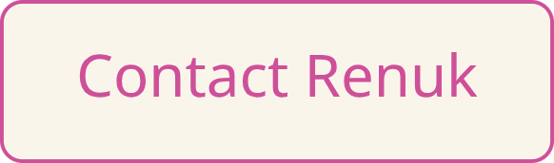
SecureVote: Building Trust in Every Vote.
Thank you for your time.

